Slide 1

Efficient, Transparent Deep Learning with LightNet
LightNet Developers
University of Maryland
College Park
Ye, Chengxi, Chen Zhao, Yezhou Yang, Cornelia Fermüller, and Yiannis Aloimonos. "LightNet: A Versatile, Standalone Matlab-based Environment for Deep Learning." In Proceedings of the 2016 ACM on Multimedia Conference, pp. 1156-1159. ACM, 2016.

Slide 2
Design principles of LightNet
Simple ☺
~1000 lines of code are used to implement the core modules.
Easy to understand ☺
Everything is implemented in plain Matlab language .
Computations are as transparent as possible.
You can set breakpoints and debug easily.
Versatile ☺
Cross platform.
Support different acceleration strategies (Multithread/CUDA/CUDNN).
A comprehensive collection of modules for neural network studies is included.

Slide 3
How to Install LightNet?
Install Matlab R2016 or later ☺
Download LightNet or clone from the project page: https://github.com/yechengxi/LightNet
(Optional) Do the above on a computer with an Nvidia GPU ☺ ☺
(Or even better) Install Neural Network Toolbox on the above computer and make sure it works. ☺ ☺ ☺
Ref to the tutorial “Transfer Learning Using Convolutional Neural Networks” in the manual.
At this time (Feb, 2017), if you are using a Pascal GPU you may need to apply a patch available from Mathworks to get the toolbox running.
https://www.mathworks.com/support/bugreports/1439741
If you are using Linux, after apply the patch you may also need to do the following (through private communication with Mathworks):
Find the following files in your matlab directory, backup them and creating the linked libraries manually by typing: ln -s -f libcudnn.so.4.0.8 libcudnn.so.4
Although there are multiple ways to get LightNet to run, the best experience we have is on a Machine with a Nvidia Pascal GPU and with Neural Network Toolbox installed. We hope this is simple enough ☺

Slide 4
Tutorial

Slide 5
To get you familiar with LightNet
There are a few common functions/scripts that will give you a high level glimpse of what LightNet contains.
Go to: LightNet/CoreModules/net/
net_ff.m: how the feed forward pass is implemented in LightNet. (straight forward)
net_bp.m: how the back propagation process is implemented. (straight forward)
test_net.m: how to use net_ff to test the neural network. (straight forward)
train_net.m: how to use net_ff and net_bp to train a neural network. (yay it’s so simple)
Main_Template: how to set up some hyperparameters to train a Multilayer Perceptron or Convolutional Neural Network.
TrainingScript: how a whole training process is carried out in LightNet.
After reading these files you should have a very clear understanding of the calculation process of LightNet.

Slide 6
How data is organized in LightNet?
Training and testing are carried out in minibatches.
We feed data by batch.
The last dimension is reserved for the batch dimension.
If you want to train an MLP network:
Data is organized as a two dimensional matrix: (feature, batch). i.e. the first dimension is reserved for input features, and the second dimension is reserved for the different inputs in the same minibatch.
LightNet/MLP/PrepareData_MNIST_MLP.m
Network weights are organized as: (dim_out, dim_in).
LightNet/MLP/net_init_mlp_mnist.m
If you want to train a Convolutional Neural Network:
Data is organized as: (height, width, feature, batch).
LightNet/CNN/PrepareData_CIFAR_CNN.m
Convolutional kernels are organized as: (hight, width, dim_in, dim_out).
LightNet/CNN/net_init_cifar_cnn.m

Slide 7
How to train a Multilayer Perceptron (MLP)
Go to LightNet/MLP
Click and run Main_MNIST_MLP_RMSPROP.m
This script shows you how to train a MLP network on the MNIST hand written digits dataset.
In this file you can see how the hyper parameters are set up.
Learning Mathod
Learning rate
Momentum
Batch size
Weight Decay
Clipping Range
All the training related parameters are then saved in struct opts.parameters
E.g. opts.parameters.lr=1e-3; opts.parameters.mom=0.9; opts.parameters.batch_size=500;
Ref to Main_Template.m

Slide 8
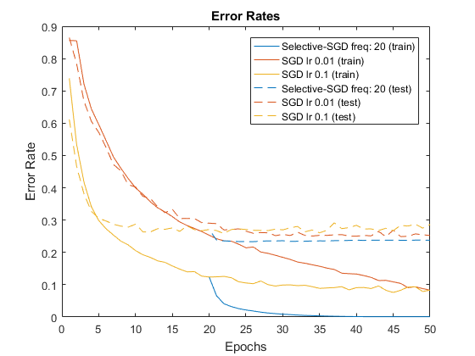
How to train a Convolutional Neural Network (CNN)
Click and run: LightNet/CNN/Main_CIFAR_CNN_SGD.m
This script shows you how to train a convolutional network on the CIFAR-10 dataset.
Like in the previous slide, you can see how the parameters are set up.
The convolutional network training can be ~5x faster on a GPU than on a CPU. The best speed is reached if Neural Network Toolbox is installed and is used. This will enable another speedup of ~10x.
Running this example:
On an Intel i7 CPU may allow you to train ~100 images per second.
On a Nvidia Pascal GPU may allow you to train 500-1000 images per second.
With functions in NN Toolbox on a Pascal GPU may allow you to train >10,000 images per second.

Slide 9
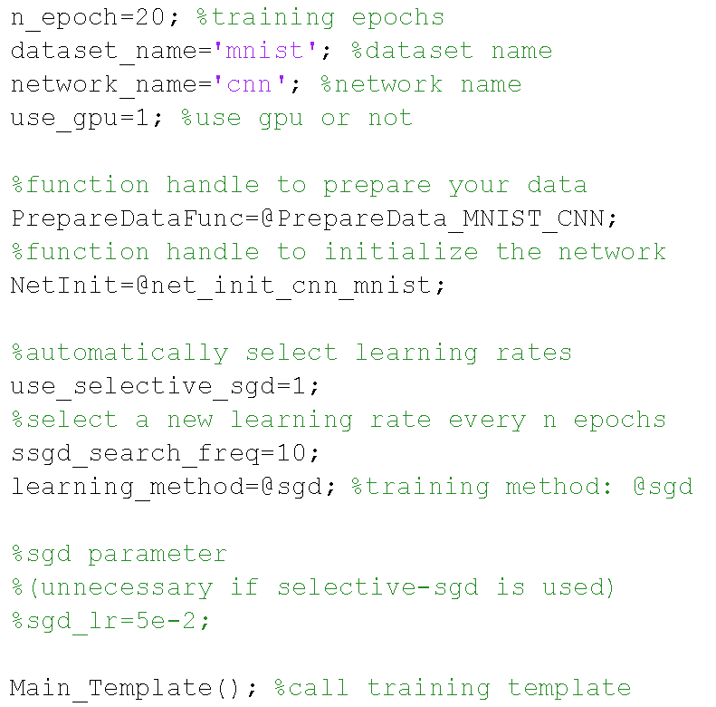
A simple template of training a CNN on the MNIST dataset

Slide 10
More advanced examples
Reinforcement Learning
LightNet/ReinforcementLearning/
Q-Network
Recurrent Neural Network
LightNet/RNN/
RNN
GRU
LSTM

Slide 11
A mathematical glimpse of LightNet
In our derivation and implementation we use the following notation: x (or sometimes I): layer input; y: layer output; z: final output of the network.
e.g. in the back propagation process, the input to a layer is dz/dy (passed from the deeper layer), the output of the layer is dz/dx (passed to the shallower layer).
For each computational element, the feed forward and back propagation process are implemented in the same file, differentiated by the number of input parameters when the function is called. We set dzdy=[] (empty) when calling the feed forward process, otherwise bp is called.

Slide 12
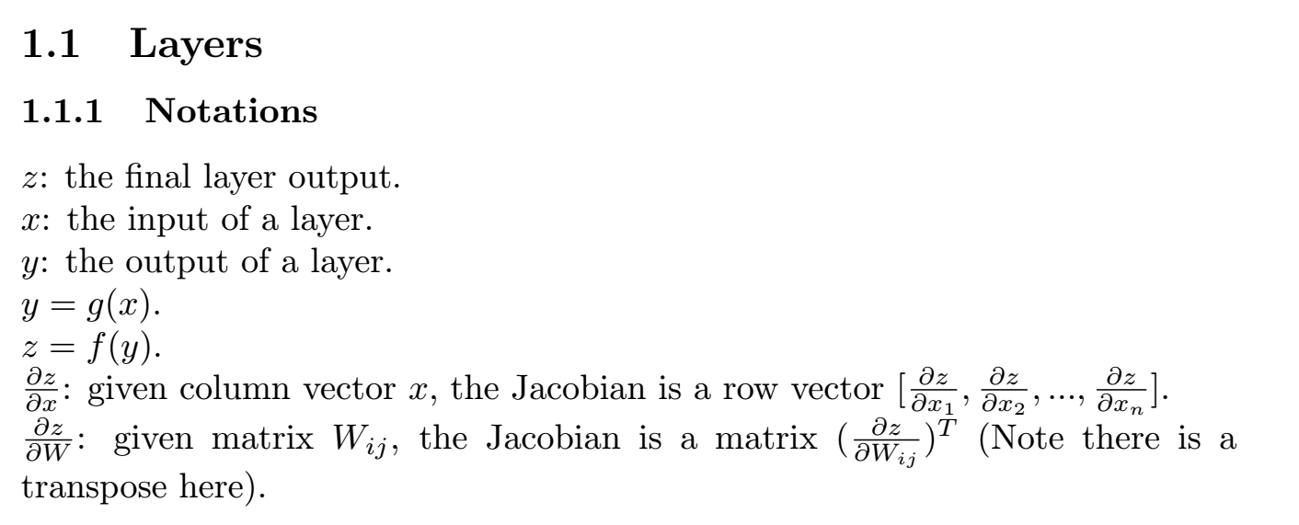
For the mathematical details, ref to “LightNet- Supplementary Materials”

Slide 13
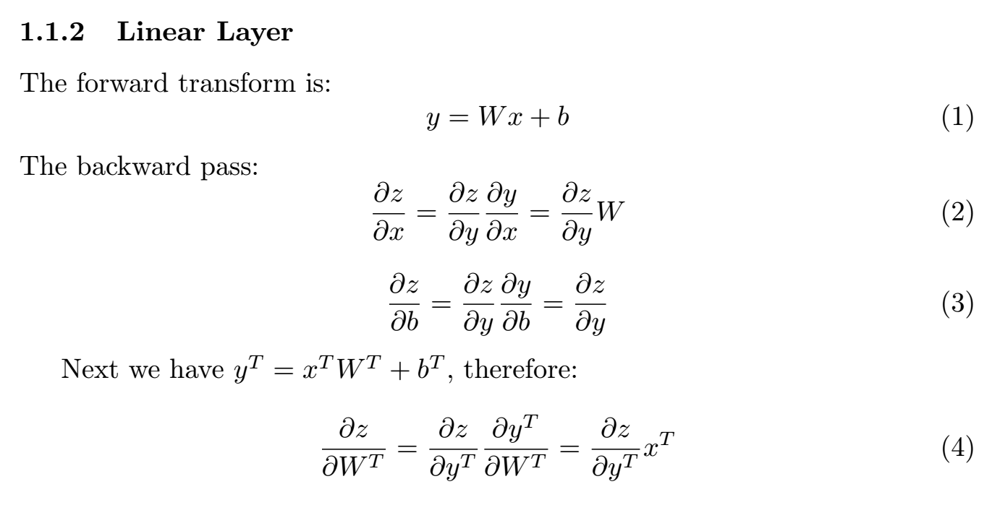

Slide 14
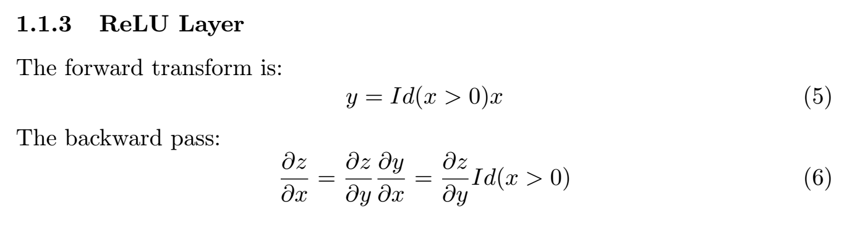

Slide 15
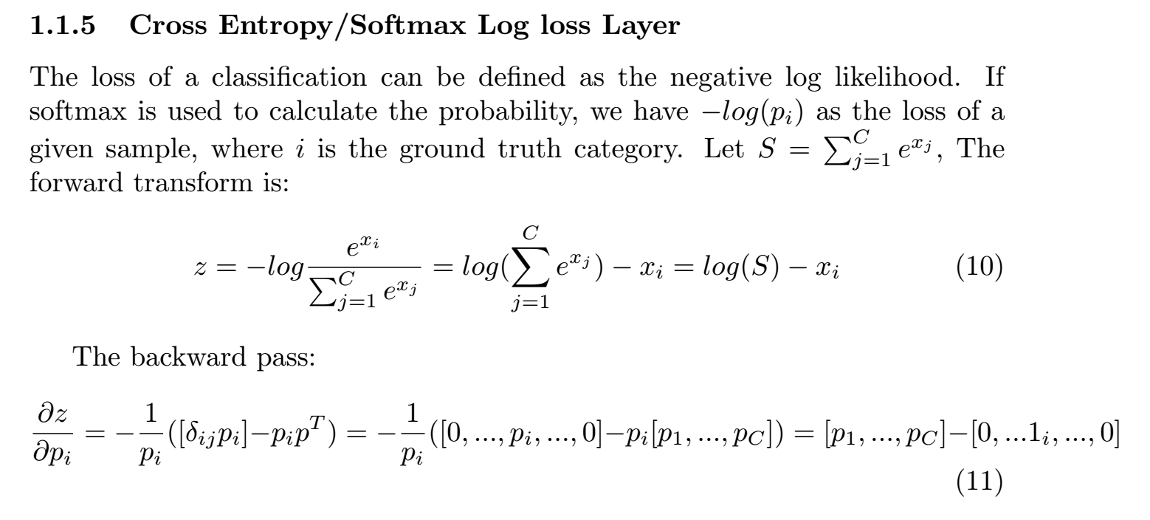

Slide 16
Recommended reading
LightNet/CoreModules/layers/
linear_layer.m
conv_layer_2d.m
maxpool.m
dropout.m
LightNet/CoreModules/activations/
relu.m
LightNet/CoreModules/loss/
softmaxlogloss.m
LightNet/CoreModules/optim/
sgd.m
rmsprop.m
adam.m

